Slide 1

Fall Seminar 2024
International Baccalaureate Program
Palm Harbor University High School

Slide 2
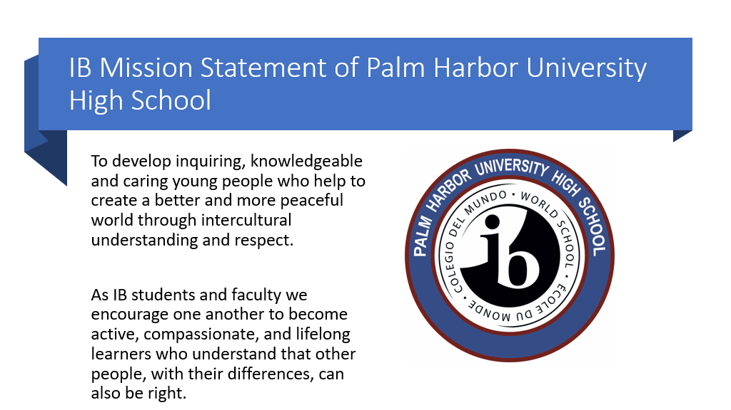
Notes:
Striblen

Slide 3
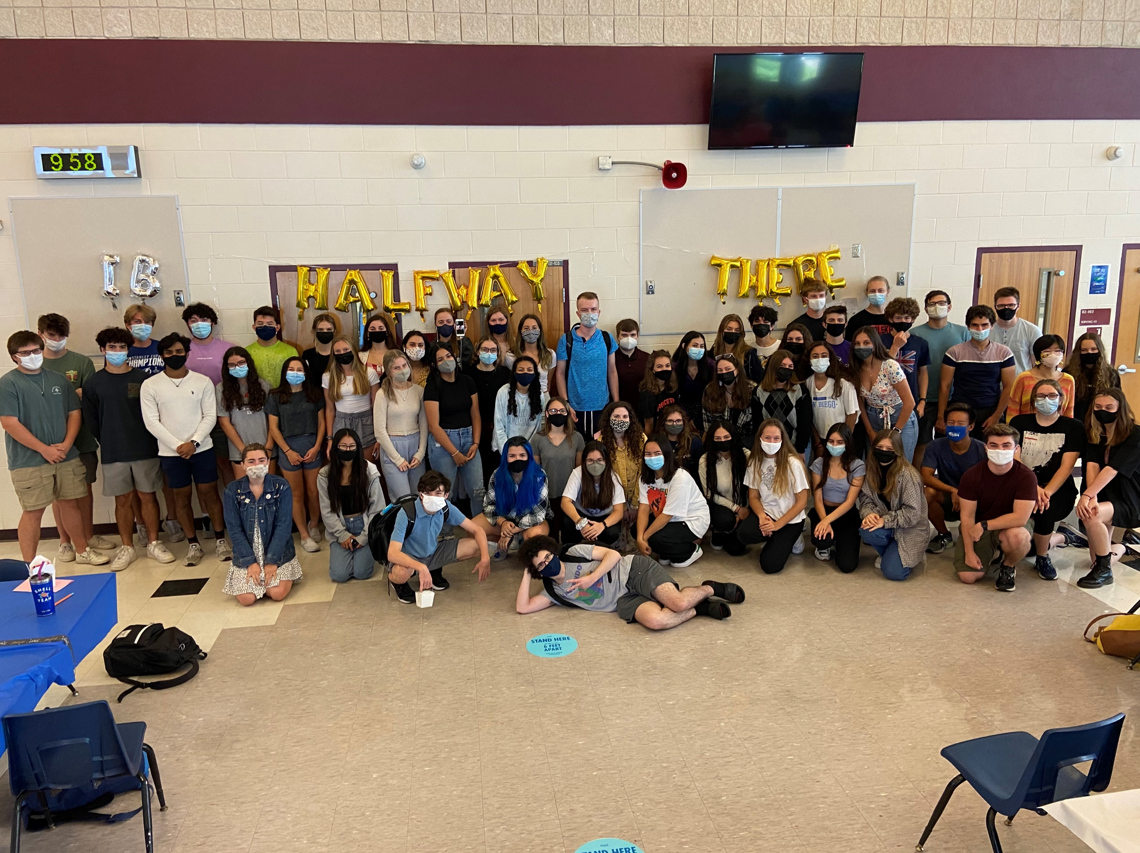
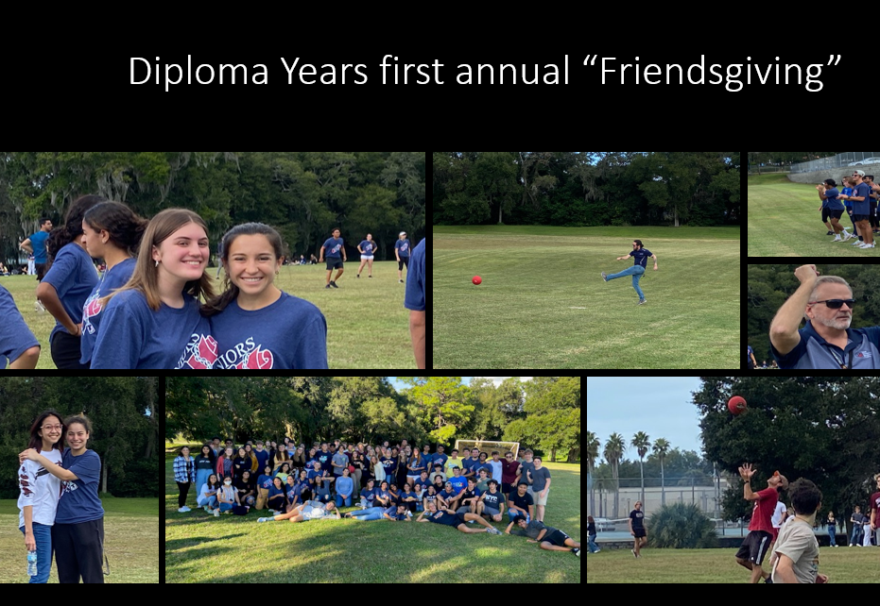
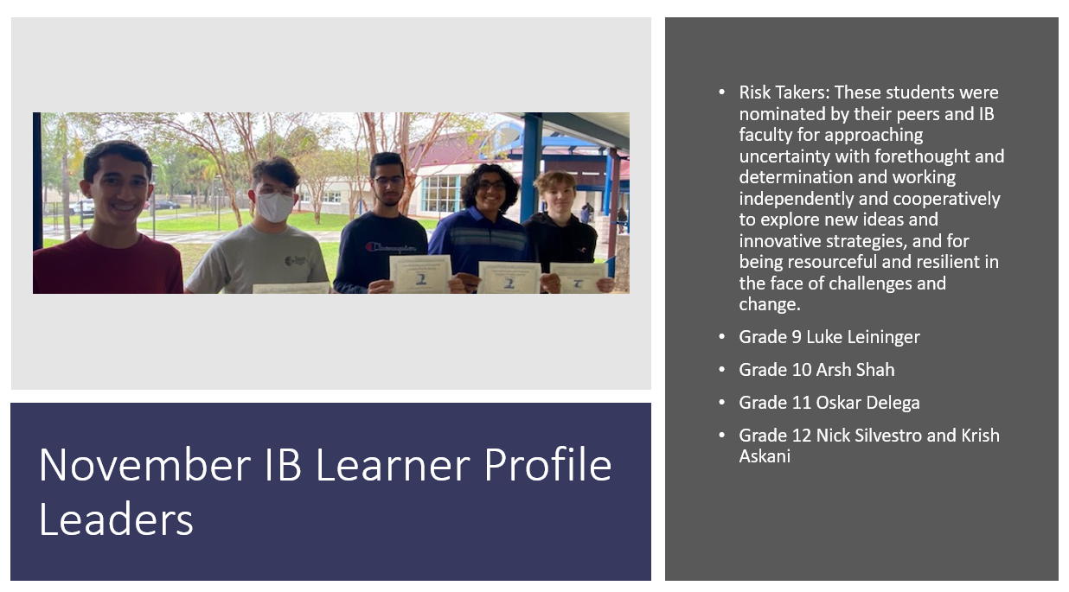
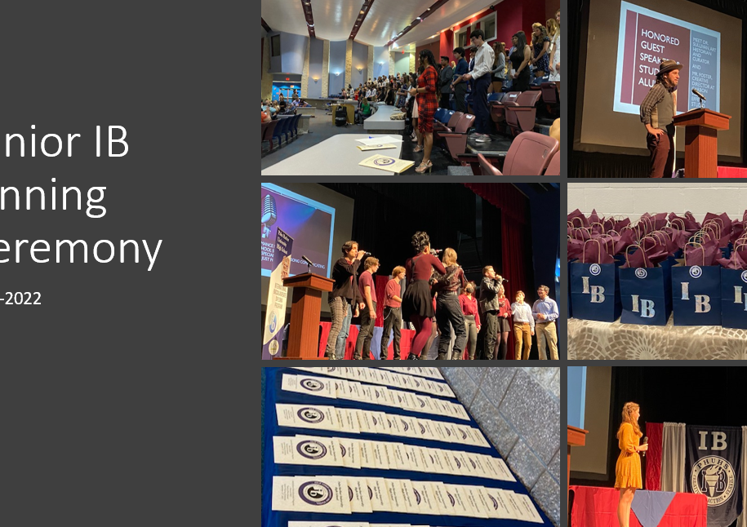
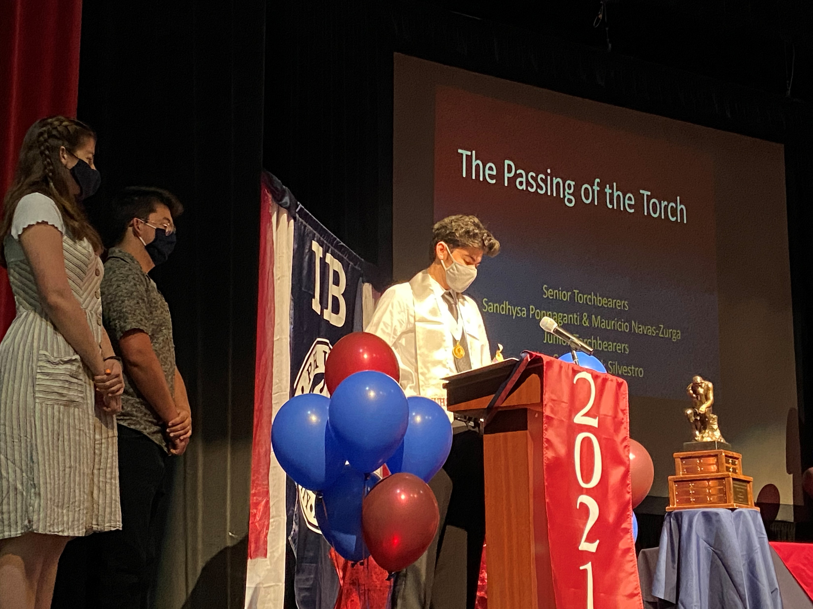
Our IB Boosters
Please welcome one of your IB Boosters, to share how you can become involved to support the wonderful events we have for our students and faculty.
Notes:
Booster Rep

Slide 4
Research from the IB
84.6% of all DP candidates enrolled in university immediately after high school compared to the national average of 66%
*99% at PHUHS IB (85% PHUHS IB attend a Florida College)
A greater percentage of DP candidates enrolled in more selective institutions
90.4% of DP candidates who enrolled in a four-year postsecondary institution immediately after high school were enrolled in the same institution the following year and 66.5% graduated within 4 years compared to the national average of 41.4%
Our students are persistent, prepared, and proficient!
Notes:
Striblen

Slide 5
More IB Research about the Benefits of the IB Core (TOK, CAS, EE)
Significantly greater likelihood of using a range of critical-thinking skills
Students felt prepared for university coursework involving research; intended to conduct future research; and found that their research skills to be important to future success;
Students developed an ethic of service; becaome more caring, open-minded, and reflective; and developed more self-confidence and maturity
DP students scored higher on 9 out of 10 items that tested their knowledge of US government structure, functioning and history.

Slide 6
College Data from the Florida Association of IB Schools:
Preliminary results of an ongoing initial survey of over 2,000 IB students in the state of Florida shows IB student acceptance rates continue to outpace the overall acceptance rates
University | IB Student Acceptance | Overall Acceptance
University of Florida | 59% | 30%
Florida State University | 78% | 37%
University of Central Florida | 90% | 36%
Princeton | 5% | 4%
Brown | 11% | 6%
University of California, Berkley | 34% | 15%
University of California, Los Angeles | 27% | 11%
New York University | 20% | 13%
University of Michigan | 40% | 20%
Duke | 12% | 6%
University of Pennsylvania | 10% | 6%
Yale | 8% | 5%
University of Virginia | 35% | 21%
Notes:
Striblen

Slide 7
IB Diploma
Bright Futures Academic Scholarship
Notes:
Shepherd-Thompson

Slide 8

Just a few PHUHS IB Highlights
Consistently surpass the percent of International Diplomas earned
79-94% diploma rate over the last 5 years
90-96% of students earned a 4-7 on their exams over the last 5 years
IB students outscore Florida and National SAT scores for Reading by over 100 points and ACT by 7 points
PHUHS IB students represent the majority of our county’s National Merit scholars annually
Over 95% of our students earn Bright Futures Scholarships
2024 Alumni received over $2 million in Bright Futures alone
PHUHS IB students are recognized consistently for their work in the community.

Slide 9
Where are our PHUHS IB alumni?
Class of 20221 | Class of 2022 | Class of 2023
Boston University Case Western Reserve University Cornell University Flordia Atlantic University Florida State University Georgia Institute of Technology John Hopkins University Massachusetts Institute of Technology Nova Southeastern University Rice University University of California, Berkley United States Marines United States Military Academy, West Point University of Florida University of Central Florida University of Notre Dame University of Southern Florida Vanderbilt University | Auburn University Bernard M. Baruch College Carnegie Mellon University Colorado State University Cornell University Florida Polytechnic University Florida State University Georgia Institute of Technology Massachusetts Institute of Technology Rensselaer Polytechnic Institute Rollins College University of Alabama University of Central Florida University of Florida University of Miami University of Notre Dame University of Pennsylvania University of Southern Florida University of Virgina | Australian National University Cornell University Florida State University George Washington University Georgia Institute of Technology Indiana University Massachusetts Institute of Technology McGill University Ringling School of Art and Design Saint Leo University Tulane University University of Central Florida University of Northern Florida University of Florida University of Florida at Santa Fe University of Southern Florida

Slide 10
Grade Level Seminars
Grade 9 Parents
Stay here in the Theatre
Grade 9 Students
Media Center
Grade 10 Parents
Teacher’s Auditorium
Grade 10 Students
Cafeteria
Notes:
Striblen

Slide 11
How we approach Teaching & Learning in IB
Thinking Skills
Social Skills
Self-Management Skills
Research Skills
Communication Skills
Inquiry
Developed in Local & Global Contexts
Designed to remove Barriers
Focus on Teamwork & Collaboration
Conceptual Understanding
Informed by Assessment
Notes:
Striblen

Slide 12
How can you support the IB Approach to Teaching and Learning?
Where & How does your student study?
Do they plan breaks?
Do they change the type of homework/studying every 45 minutes to switch their brain’s gears?
Location matters: think noise, brain association, distractions
How do they organize their time?
Planners
Making time for joy
Focusing on A day A night, B day B night, C day C night
Self-Advocacy
Ask your teachers for help; they are there to support you, but they need to when you need their help, including when you’re just struggling with life stuff!
Attend available tutoring times
Notes:
Striblen

Slide 13
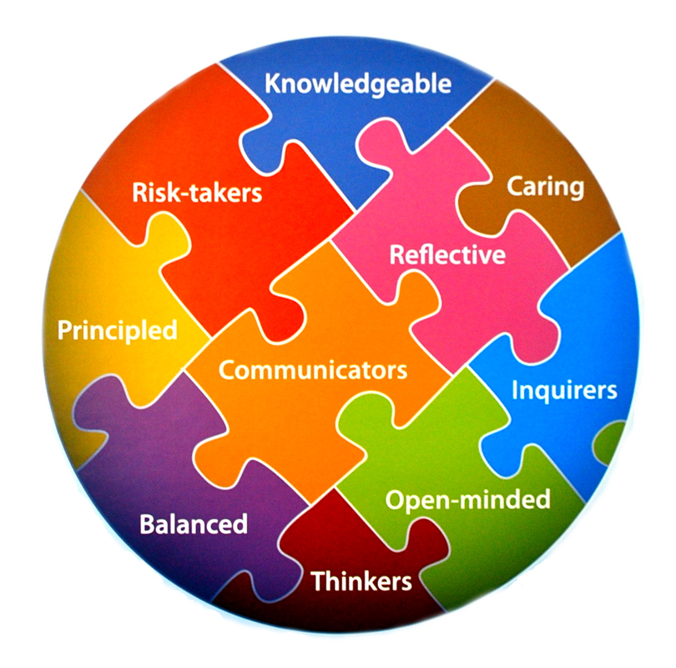
The IB Core is gradually introduced to our Pre-IB students through the common planning of their teachers and staff and through the skills taught in Inquiry Skills
    CAS
    TOK
    EE
These are an integrated whole in developing ourselves with the attributes of the IB Learner Profile
Notes:
Tancrell

Slide 14
The IB Core – CAS
Students WILL earn their Bright Futures service requirements in CAS during their Junior and Senior years
Creativity-Activity-Service
Divided among the three areas
Planned (approved)
Activities carried out continuously over time
Documented; evidenced
Signed off by an objective adult supervisor
Required interviews and reflection
Final review by IB CAS Coordinator
Notes:
Tancrell

Slide 15
Start Preparing for CAS…
How is your student getting involved?
Leadership, growth, impact
Quality
Number of “things”
Quantity
Clubs
Sports
Service
Leadership
Notes:
Tancrell

Slide 16
5 Main Projects in 9th grade
Practicing ATL Skills
Gading Period 1
Global issue Presentation
Grading Period 2
Mini EE on History or Literature Focus
Grading Period 3
Exploration of Math and Science EE writing
Grading Period 4
Debates

Slide 17
The IB Core – Pre-IB Students will engage in writing
1 mini EE
RESEARCH
INVESTIGATION
ACADEMIC INQUIRY
Reasoned examination of an intellectual nature in which established sources of academic merit are assessed and applied in the creation of authentic writing
Consideration of different styles of writing for different subject areas
Notes:
Tancrell

Slide 18

The aims of the mini-extended essay are for students to:
engage in independent research with intellectual initiative and rigor
develop research, thinking, self-management and communication skills
reflect on what has been learned throughout the research and writing process.
(Source: IBO, Extended Essay Guide First Examinations 2018)
Notes:
Tancrell

Slide 19
What does this translate into?
The IB Research about the IB Core
Significantly greater likelihood of using a range of critical-thinking skills
Students felt prepared for university coursework involving research; intended to conduct future research; and found that their research skills to be important to future success;
Students developed an ethic of service; becaome more caring, open-minded, and reflective; and developed more self-confidence and maturity
DP students scored higher on 9 out of 10 items that tested their knowledge of US government structure, functioning and history.
Notes:
Tancrell

Slide 20
PSAT
Why Take the PSAT/NMSQT?
See your progress over every PSAT you have taken and track your improvement.
CAREERS: Explore careers that you're passionate about on BigFuture by taking the Career Quiz and learning how your test performance aligns to 1,000 occupations with our career readiness indicator.
COLLEGES: Search over 3,000 college profiles on BigFuture to discover which colleges and programs are right for you. Filter by location, major, and more.
SCHOLARSHIPS: Use your scores to access scholarships from BigFuture Scholarships, and thousands of others.
SAT PRACTICE: Send your scores to Khan Academy® for a free, personalized SAT practice plan based on your test results.
AP POTENTIAL: See which courses are offered at your school and which classes match a future major that may interest you.
Your SCORE REPORT will give details on each question and answer. Show how you did, give the right and wrong answers and why.
The SCORE REPORT will also provide insight into strengths and weaknesses.

Slide 21
Preparing for the NMSQT
National Merit Scholarship Qualifying
Test:
Junior Year
PSAT is Taken in October every year
Qualifies you for scholarships and recognition for college applications in JUNIOR year

Slide 22
BRIGHT FUTURE SCHOLARSHIPS
FLORIDA ACADEMIC SCHOLARSHIP
FLORIDA MEDIALLION SCHOLARSHIP
3.5 GPA
29 ACT
1340 SAT
100 Hours
3.0 GPA
25 ACT
1210 SAT
75 hours

Slide 23
IB Diploma
Bright Futures Academic Scholarship
Notes:
Shepherd-Thompson

Slide 24
Start Researching Colleges and Careers Now
Visit local colleges
Go online to check out colleges in subjects you’re interested in and locations you’d love
Go to the virtual and in person College Fairs in the community
Talk to teachers, family friends, mentors about their careers and colleges they attended
Notes:
Shepherd-Thompson

Slide 25
College Research - Where do They want to go?
Xello!
Florida Shines - www.floridashines.org
Big Future Collegeboard - www.bigfuture.collegeboard.org
eCampus Tours - ecampustours.com
Admittedly - admitted.ly
Cappex - cappex.com
Chegg - chegg.com
College Raptor- collegeraptor.com
Is this college a good fit for me?
  Do they have my major?
  SAT?
  ACT?
  GPA?
  LOCATION?
  Is the price tag realistic?
  What is their 4 year graduation rate?
  What is their avg freshman retention rate?
  Are there options for study abroad?
  Are their students employed upon graduation?

Slide 26
SAT – collegeboard.org
2 sections
Scoring - range 200-800
Fee Waiver
Superscoring
Critical Reading & Writing
Math
800 max
total is 1600

Slide 27
ACT – act.org
4 sections
Scoring - Range
1-36
Each section gets scored
Composite = all sections averaged together
Super scoring
Fee Waiver
English, Math, Reading, Science

Slide 28
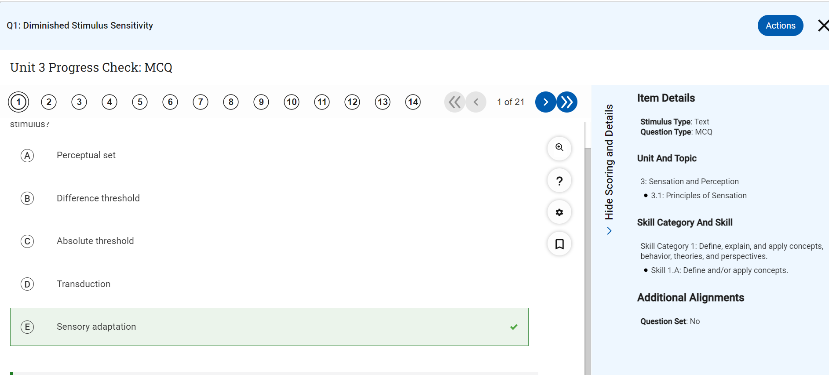
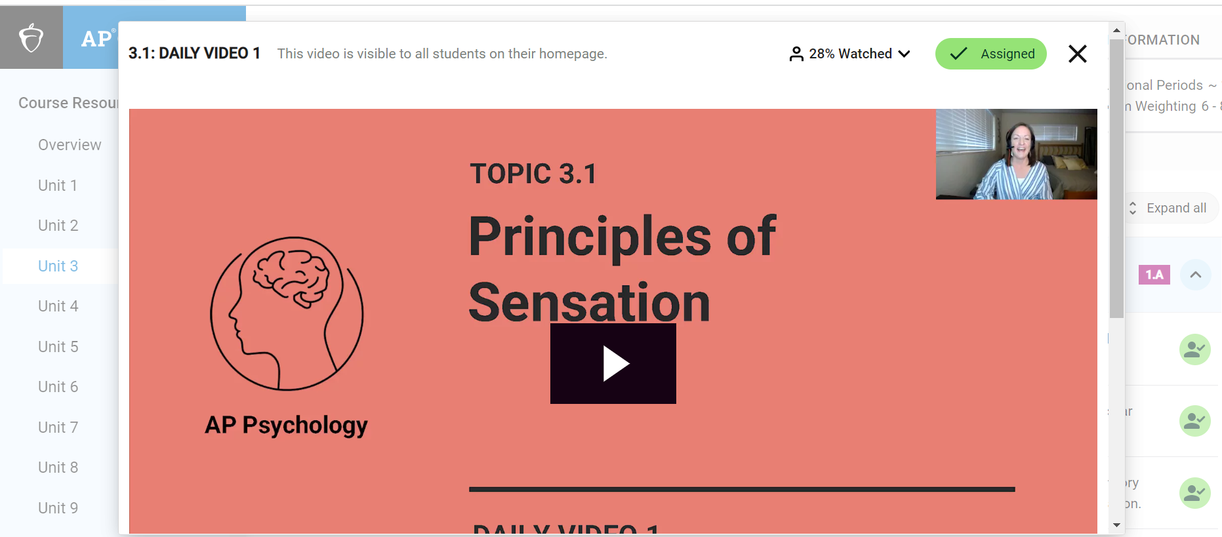
Advanced Placement Support
  AP Classroom
  Log in with College Board Account
  Daily Videos
  Unit Progress Checks
Notes:
Dindial-Thompson

Slide 29
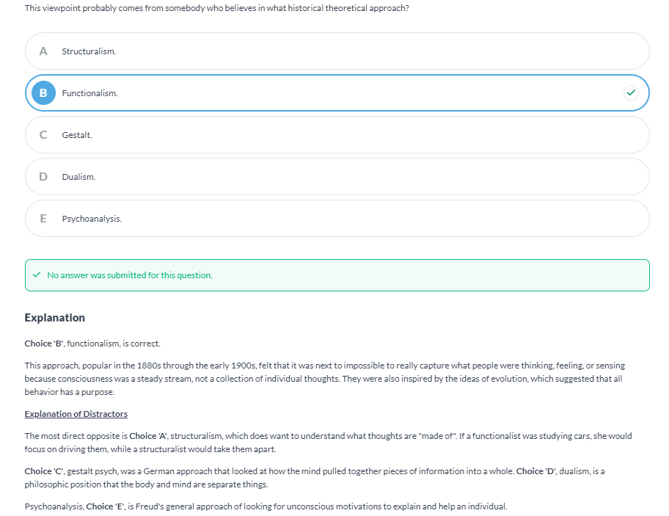
Advanced Placement Support
  AlbertIO
  Log in via Clever
  Organized by unit
  Teacher assigned work or student independent practice
  Explanation of correct answers
  Explanation of distractors
Notes:
Dindial-Thompson

Slide 30
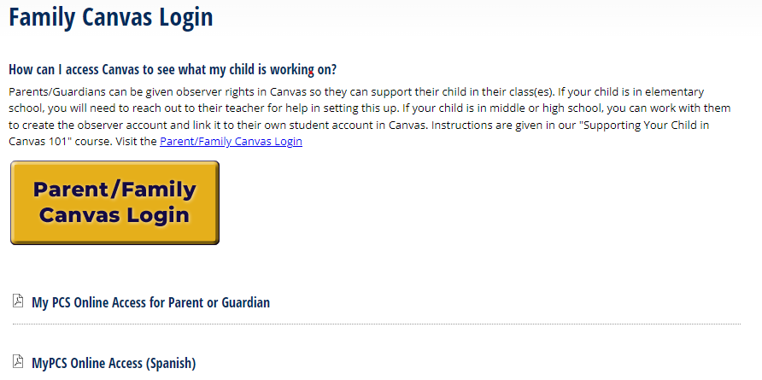
Advanced Placement Support
  Canvas
  Parent log in or student log in.
  Homework and instructions for assignments are posted
Notes:
Dindial-Thompson

Slide 31
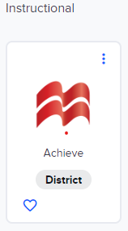
Advanced Placement Support
  Canvas
  Parent log in or student log in.
  Homework and instructions for assignments are posted
Notes:
Dindial-Thompson

Slide 32
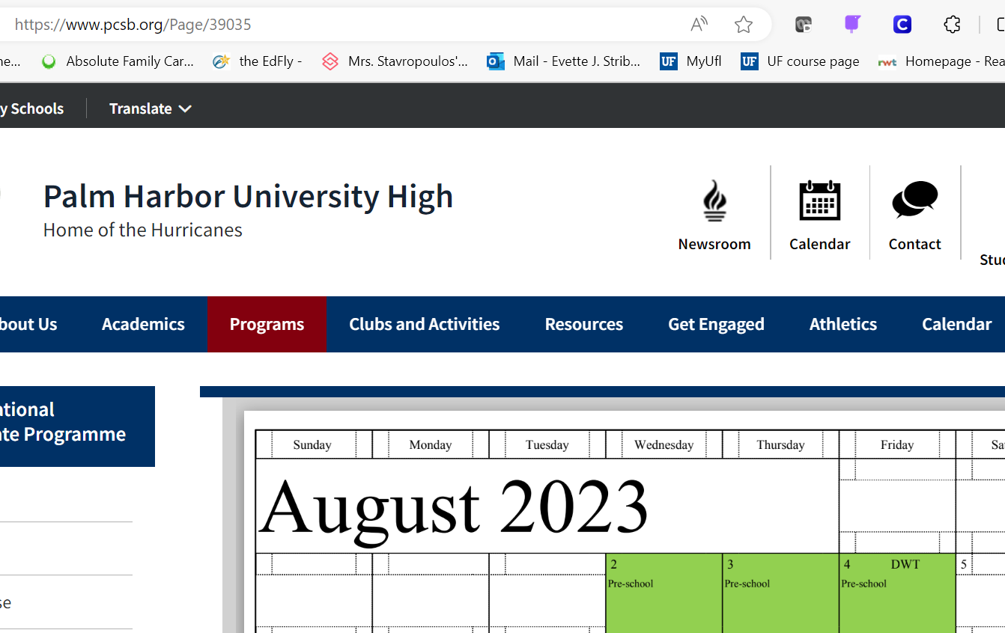
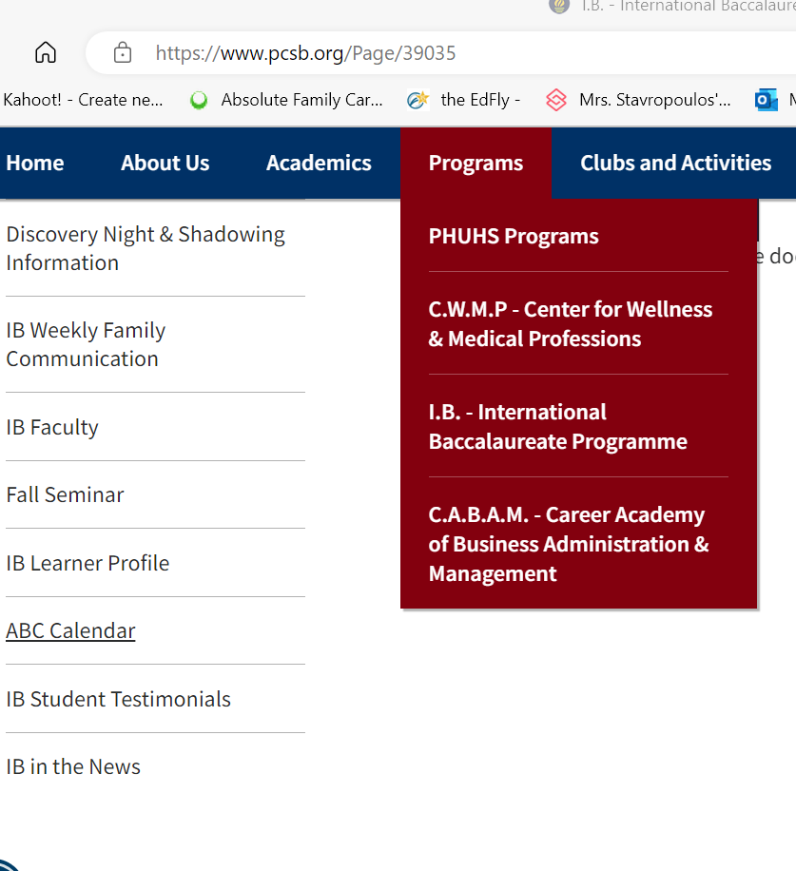
Important Dates: Check Website ABC Calendar
Notes:
Striblen

Slide 33
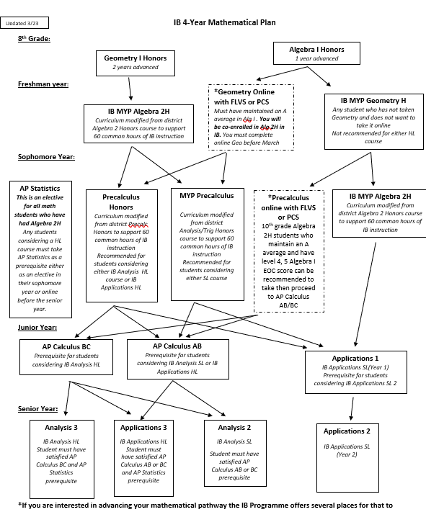
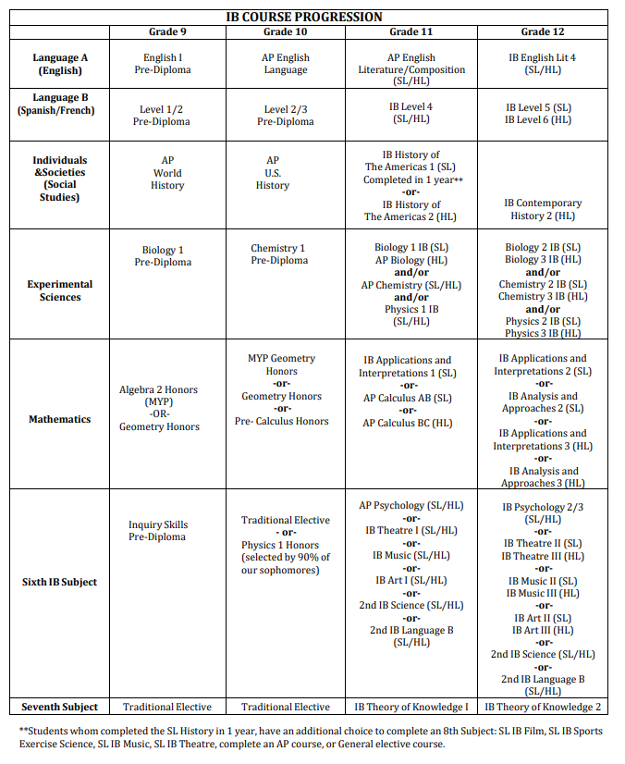
IB Course Progression
(handouts provided)

Slide 34
IB, GPA, and College Course Credits
Students typically earn up to 45 college credits (Florida University System)
All Junior and Senior courses are IB courses—college level
All Freshman and Sophomore courses are Honors or AP level
Students may take Dual Enrollment and additional Honors, AP, etc. courses during the summer
Students may participate in executive internships during the summer after their Junior year
The majority of Universities accept IB credits in some way—see our website to learn more

Slide 35
IB | AP | DE | Benefits
Full Course Meal | Buffet | Home cooked meal | AP Pick and choose College Level Course with GPA advantage Nationally recognized Teachers trained by College Board
Curriculum set, monitored, & assessed by The International Baccalaureate Organization (IBO) | Curriculum set, monitored, & assessed by College Board | Curriculum set by local Junior College | IB Internationally recognized Interdisciplinary instruction between teacher teams/subjects AP/IB teacher planning through District and site based teacher teams Includes research opportunities highly recognized by colleges through internal assessments and extended essay in the Junior and Senior years Teachers trained by IBO, most also trained by College Board Students are in ALL Honors, AP, and IB level courses through 9-12 impacting their knowledge built and GPA
IB Programme Includes AP courses in progression and ability to take DE during summer | Individual Courses | Individual Courses
Opportunity to earn college credit for IB courses based on exam (1.0 GPA weight based on grade), Honors credit for Pre-IB (.5 GPA weight based on grade) | Opportunity to earn college credit (based on exam) per course and 1.0 GPA weight (based on grade) | Opportunity to earn college credit based on grade and 1.0 GPA weight | DE College Credit and GPA advantage College Credits & GPA advantage College Transcript Begun

Slide 36

Please Welcome our AMAZING IB DP Student Panel
Notes:
Shepherd-Thompson

